Slide 1

TEXT analytics of TED Talks

Slide 2
CLIENT
TED talks are very famous in recent years.
The ideas spreads through TED talks are amazing.
TED talks cover most of the people interested topics includes lifestyle, technology, arts and so on.

Slide 3
PROBLEM STATEMENT
Creation of Recommendation engine for the viewers based on the current selection
Sentiment Analysis of the talk transcripts
Predict the ratings of the talks
Topic Modelling

Slide 4
DATA
TED talk data collected from Kaggle.
https://www.kaggle.com/rounakbanik/ted-talks
https://www.kaggle.com/goweiting/ted-talks-transcript
The first data contains the details about the talk and the next one is the transcripts and the feature
from the YouTube.

Slide 5
Data Wrangling - Challenges
Main challenges in merging YouTube data and TED DATA:
No common field like Video ID.
The details are only the title name and speaker names.
Titles are not exactly alike in both dataset.
As there is a chance that one speaker delivered more than one titles, we cannot match only with speaker names, so merging based on titles is the best bet.
The format of the title is completely different, TED data contains title alone, but YouTube data have 'title|speaker' or 'speaker|title' as formats.

Slide 6
Data Wrangling - Strategy
Using pandas. series. String functions like strip, replace and concatenate the texts in the titles are cleaned.
As YouTube have no separate columns for title, speaker and title are separated into new columns using merge and split functions.
First titles with exact match of words are matched by merging based on TED and YouTube titles.
Second rows of speakers with only one talk are filtered and merged based on speaker names.
But the real hurdle was merging the titles of same talks but described with different words, so using nltk package the words are tokenized.
To find the similarity between words, cosine similarity which is popular to match similar words with good degree of accuracy is used to merge based on similarity values.

Slide 7
Exploratory Data Analysis
Pictures worth Thousand words. EDA helps in visualizing data in different angles.
EDA is performed as a comparison between YouTube and TED data
Impact of Talk on viewers
Categories with most views
TED talk familiarity with viewers over years

Slide 8
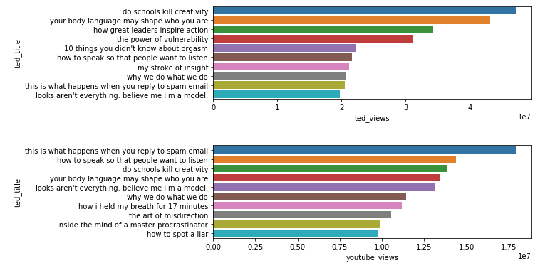
TITLE WINNERS

Slide 9
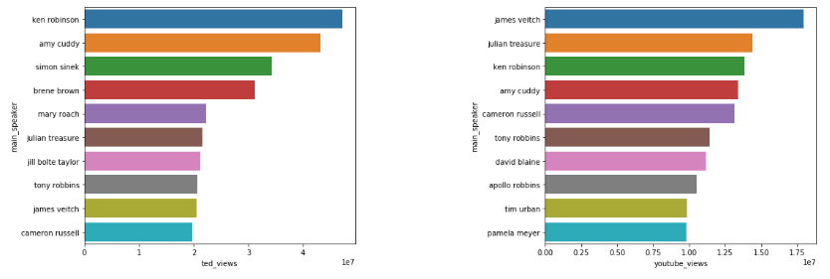
Best Speakers

Slide 10
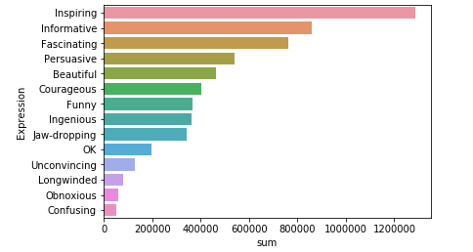
Impact of TED Talk

Slide 11
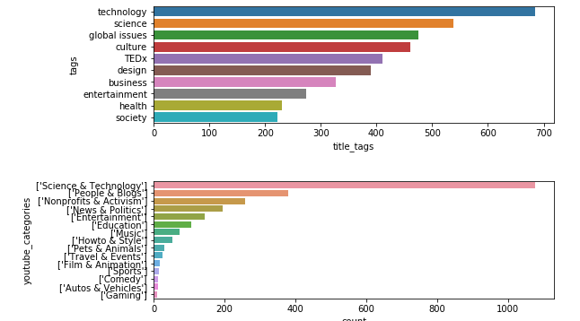
Exploring Categories

Slide 12
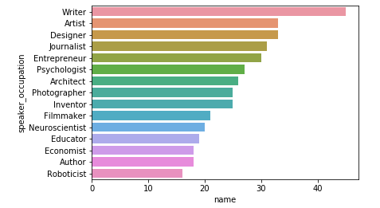
Diverse Occupations of speakers

Slide 13
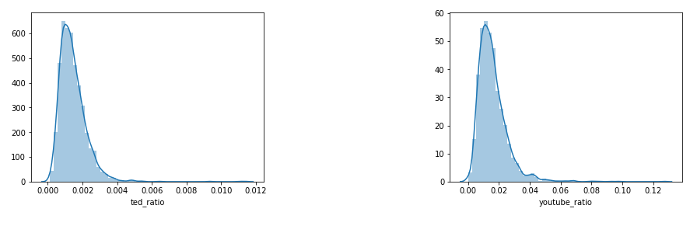
Viewers willingness to comment

Slide 14
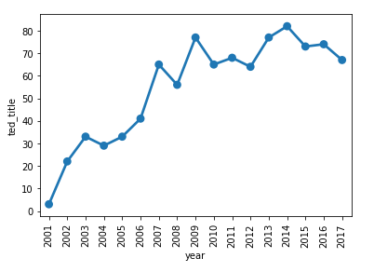
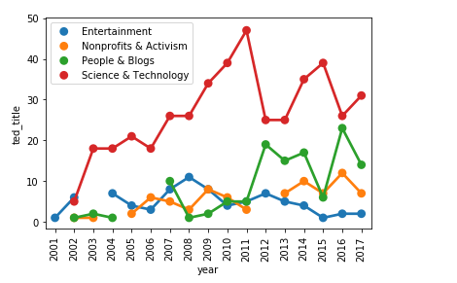
TED Talk growth over years

Slide 15
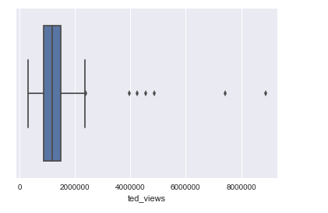
Great Response for TED Women
Most of the TED Women talks have 1 Million to 1.8 Million.
The range is pretty good as the count of views is consistent among all the talks

Slide 16
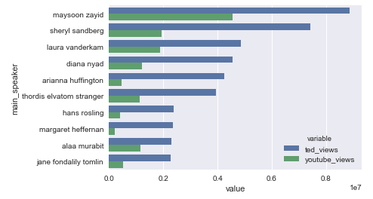
Best Women Speakers

Slide 17
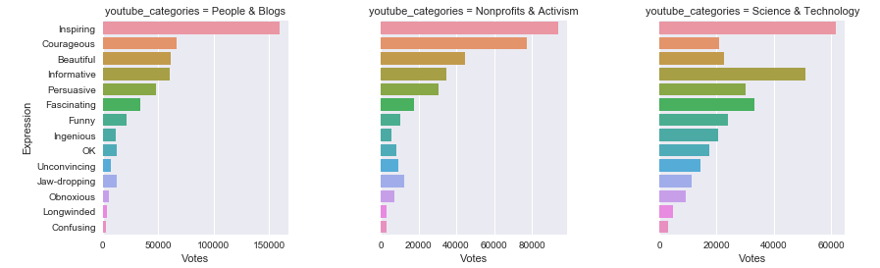
Top 3 Categories - Impact

Slide 18
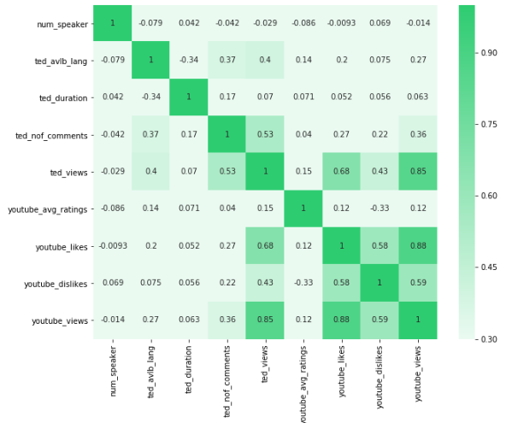
Numbers speaks correlation

Slide 19
TED Scripts – Text Analytics
Kaggle TED Data Set contains the scripts of all Talks. By applying NLP techniques, we can uncover hidden features behind the text that gives us a way for
Recommendation systems
Topic Modelling
Clustering.

Slide 20
Text Pre-Processing
As Data Wrangling is an important step in Data Science process, similar way text pre-processing is required for any text analysis. They are as follows
Removing Accented characters
Expanding Contractions
Removing Special Characters
Removing Stop Words
Lemmatization
Stemming
Removing unnecessary White spaces

Slide 21
Tokenization TF - IDF
TF-IDF stands for Term Frequency - Inverse Document Frequency
TF(t) = (Number of times term t appears in a document) / (Total number of terms in the document).
IDF(t) = log_e(Total number of documents / Number of documents with term t in it).

Slide 22
Recommendation System
Recommendation system will be built based on a similarity measure. There are several similarity measures available most prominent are Jaccard, Cosine, Euclidean distance and Manhattan distance.
Cosine similarity metric finds the normalized dot product of the two attributes. By determining the cosine similarity, we would effectively try to find the cosine of the angle between the two objects. The cosine of 0° is 1, and it is less than 1 for any other angle.

Slide 23
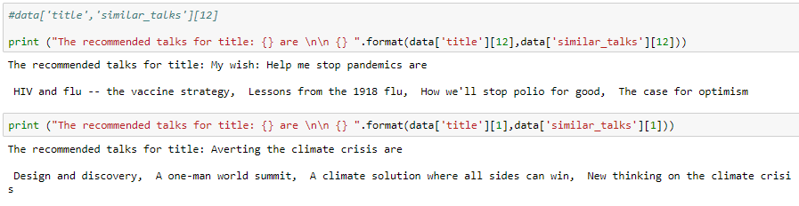
Results

Slide 24
Topic Modelling - LDA
Latent Dirichlet Allocation (LDA) uses two probability values:
P (word | topics) and P (topics | documents).
NMF is a deterministic algorithm which arrives at a single representation of the corpus. For this reason, NMF is often characterized as a machine learning algorithm. Like LDA, NMF arrives at its representation of a corpus in terms of something resembling “latent topics”.

Slide 25
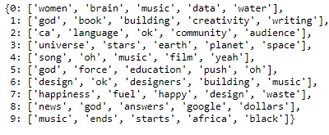
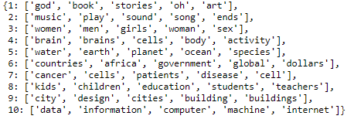
LDA - NMF
LDA
NMF

Slide 26
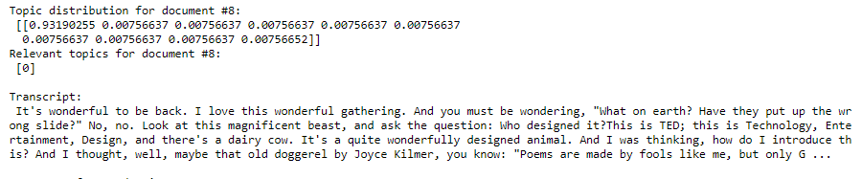
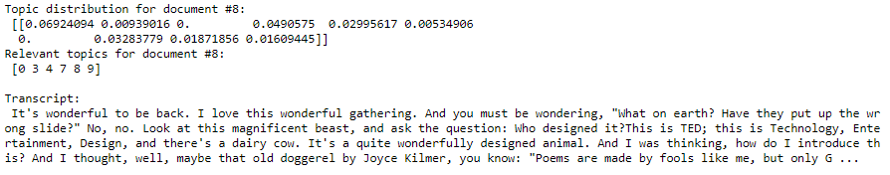
Comparing Results
LDA
NMF

Slide 27
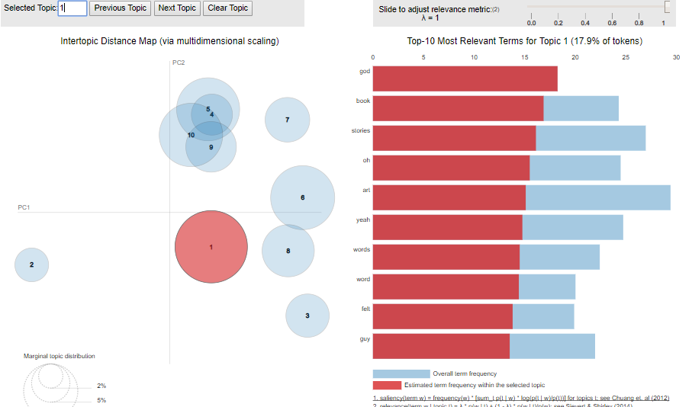
Visualization

Slide 28
Clustering
Best-known clustering approaches K-Means and Hierarchical Clustering
K-Means
By K-Means Clustering a data set can be segregated into K distinct, non-overlapping clusters. K needs to be decided before the algorithm application.
Hierarchical clustering
considers each data point as one cluster. Next data point will be added to the previous cluster if it is close by. Process will be repeated till we get one giant cluster. The history tree thus formed is called a Dendrogram.

Slide 29
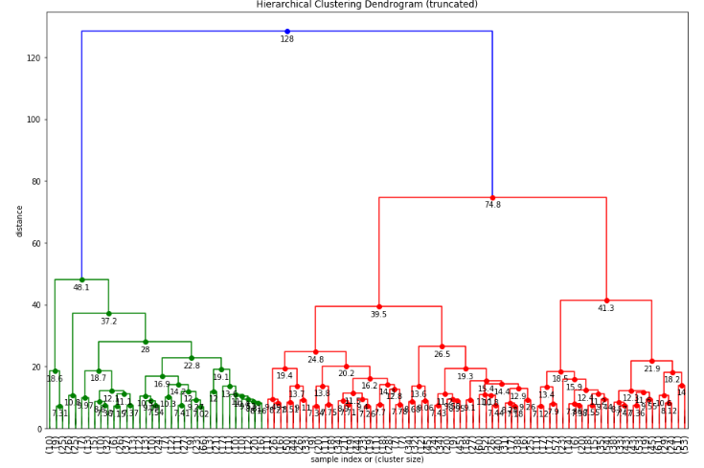
Truncated Mode

Slide 30
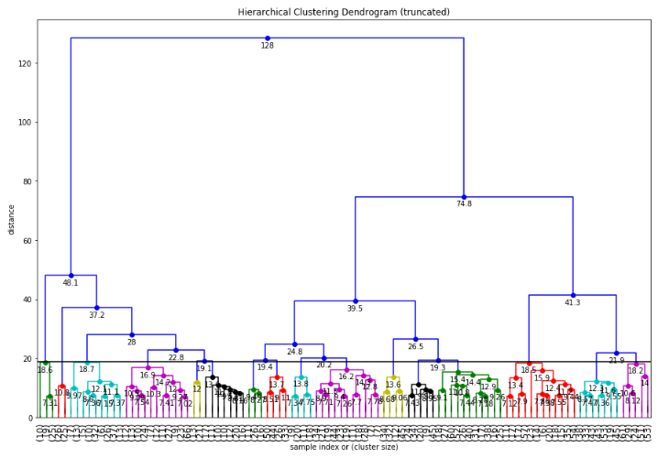
Cut-off Distance = 19

Slide 31
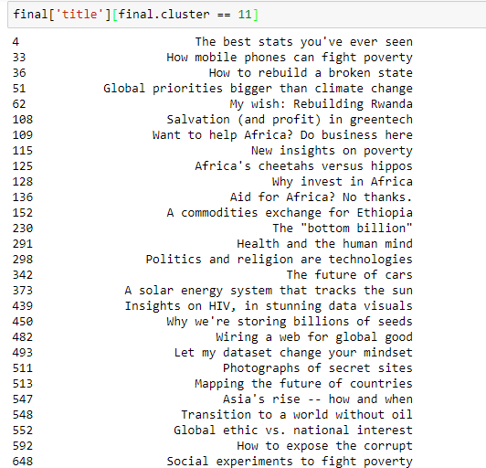
Cluster - Issues and improvements in different parts of the world (Geography)

Slide 32
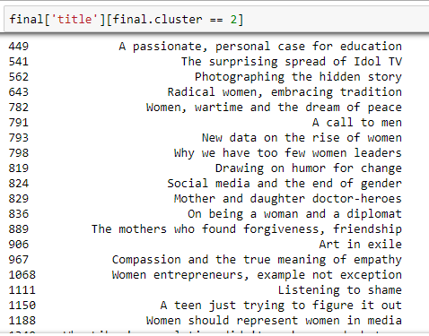
Cluster depicting the Topics related to Women

Slide 33
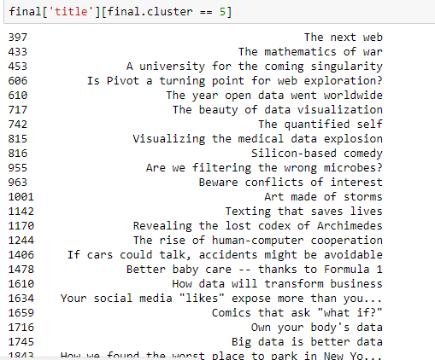
Cluster depicting the Topics related to Technology and Data

Slide 34
Conclusion & Future Work
NLP techniques like topic modelling, similarity findings help in building recommendation systems and customizing search tags.
Clustering helps in placing the talk in right groups based on text analysis.
Future work can be extended in identifying the top rating talks based on text scripts.
Applying word2vec for vectorization and other Deep Learning techniques.

